Slide 1

Continuous Integration (Jenkins)

Slide 2
Agenda
What’s Continuous Integration
Jenkins
Features
Plugin
Security Management
Demo
Q&A
2

Slide 3
What’s Continuous Integration?
•
In software engineering, continuous integration (CI) implements continuous processes of applying quality control - small pieces of effort, applied frequently.
Continuous integration aims to improve the quality of software, and to reduce the time taken to deliver it, by replacing the traditional practice of applying quality control after completing all development.
Ref: http://en.wikipedia.org/wiki/Continuous_integration
3

Slide 4
History
•
Continuous Integration emerged in the Extreme Programming (XP) community, and XP advocates Martin Fowler and Kent Beck first wrote about continuous integration circa 1999.
4

Slide 5
Continuous Integration
•
Continuous Integration is a software development practice where members of a team integrate their work frequently, usually each person integrates at least daily - leading to multiple integrations per day.
Each integration is verified by an automated build (including test) to detect integration errors as quickly as possible.
-- Martin Fowler
Ref: http://martinfowler.com/articles/continuousIntegration.html
5

Slide 6

Why Continuous Integration?
Integration is hard, effort increase exponentially with
Number of components
Number of bugs
Time since last integration
Ref: http://www.slideshare.net/carlo.bonamico/continuous-integration-with-hudson
6

Slide 7
Continuous Integration Benefit
Project Management
Detect system development problems earlier
Reduce risks of cost, schedule, and budget
Code Quality
Measurable and visible code quality
Continuous automatic regression unit test
7

Slide 8
8

Slide 9
Best Practice of CI
Single Source Repository.
Automate the Build and Test
Everyone Commits Every Day
Keep the Build Fast
Everyone can see what's happening
Automate Deployment (Optional)
9

Slide 10
What’s Jenkins
An open source CI server
More then 85000 installations (May 2014)
Plug-in extensibility (Over 900 plugins)
MIT license
10

Slide 11
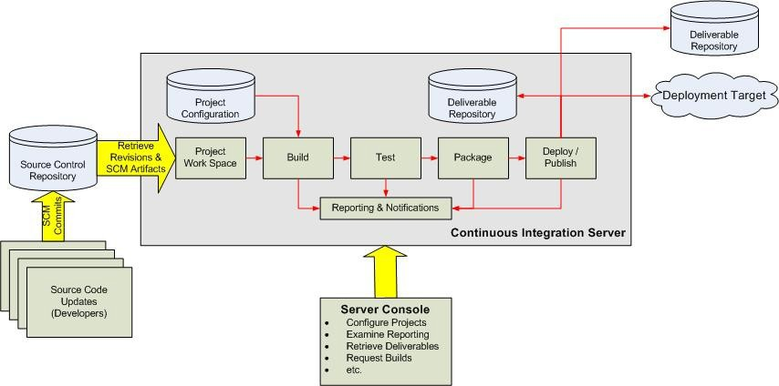
Continuous Integration Overview
Ref: http://www.javaworld.com/javaworld/jw-12-2008/images/CIOverview.jpg

Slide 12
Jenkins Features
Trigger a build
Get source code from repository
Automatically build and test
Generate report & notify
Deploy
Distributed build

Slide 13
Jenkins Requirement
Web Server (Tomcat, WebLogic, …)
Build tool (Maven, Ant)
SCM (Git, Svn, Cvs, …)

Slide 14
Jenkins Plugins
Build triggers
Source code management
Build tools
Build notifiers
Build reports
Artifact uploaders
UI plugins
Authentication and user management

Slide 15
Build Trigger
Manually click build button
Build periodically
Build whenever a SNAPSHOT dependency is built
Build after other projects are built
Poll SCM
IRC, Jabber, …

Slide 16
Get Source Code (1/2)
CVS (build-in)
SVN (build-in)
GIT (requires Git)
ClearCase (requires ClearCase)
Mercurial, PVCS, VSS, …

Slide 17
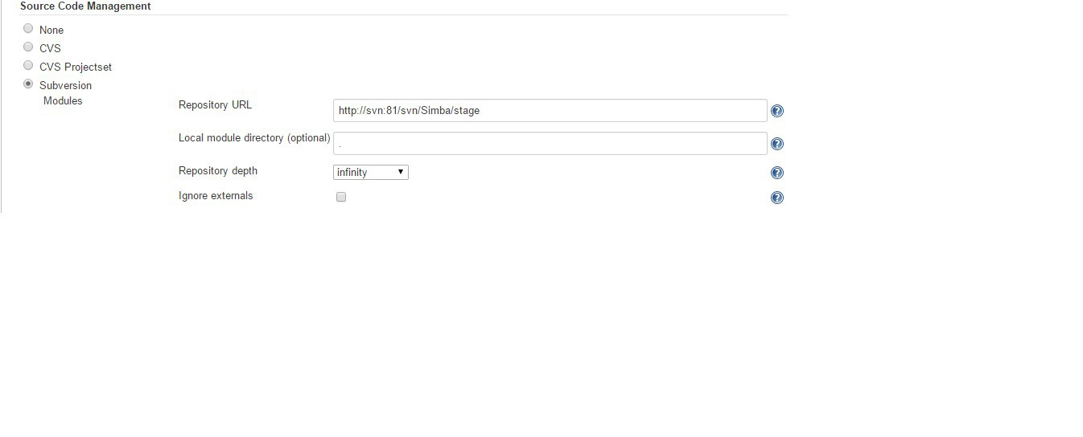
Get Source Code (2/2)
Get current snapshot
Get baseline (tag)

Slide 18
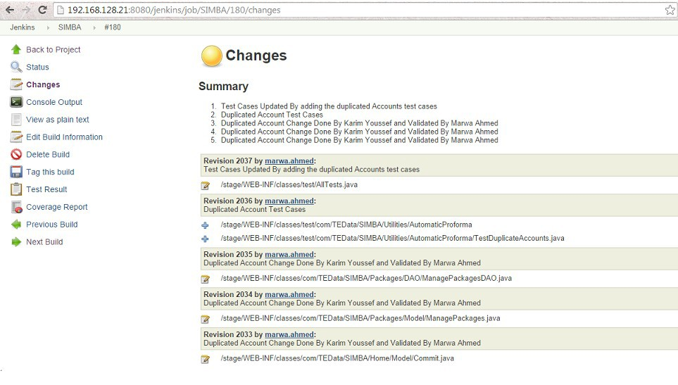
Code Change History

Slide 19
Build Tools
Java
Maven (build-in), Ant, Gradle
.Net
MSBuild, PowerShell
Shell script
Python, Ruby, Groovy

Slide 20
Build Wrapper
Build name (version no) setter
Virtual machine (VMWare, Virtual Box)
Set environment variable
ClearCase release plugin
…

Slide 21
Build Notifier
E-mail
Twitter
Jabber
IRC
RSS
Google calendar
…

Slide 22
Build Report
Static Code Analysis
Checkstyle, PMD, Findbugs, Compiler Warning
Test Report & Code Coverage
JUnit, TestNG, Cobertura, Clover
Open Tasks

Slide 23
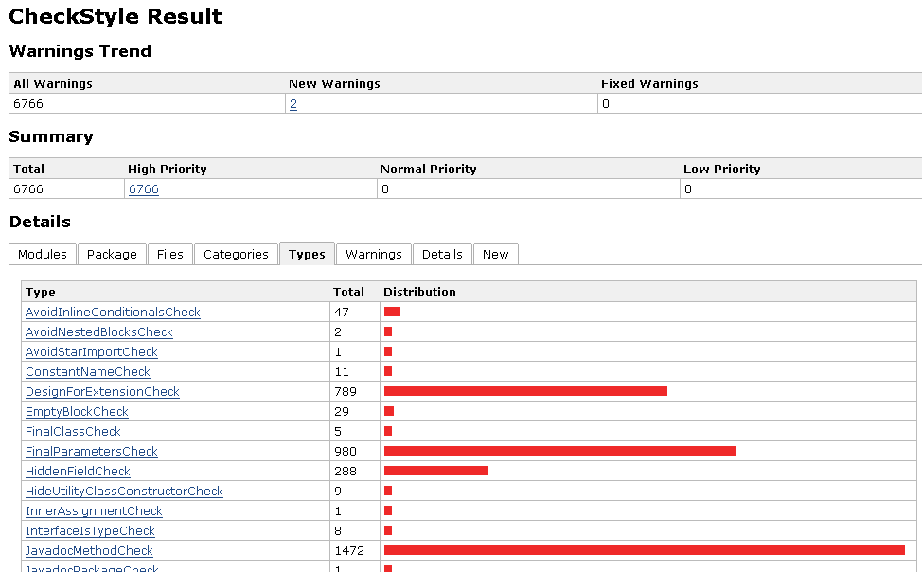
CheckStyle
23

Slide 24
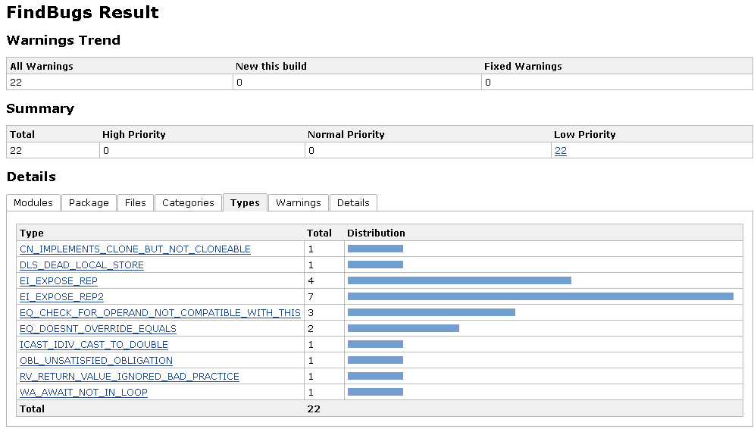
FindBugs

Slide 25
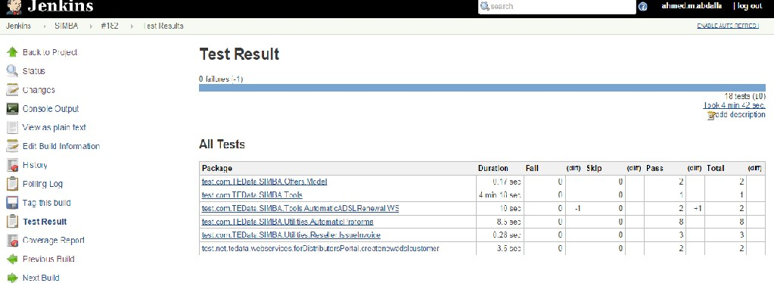
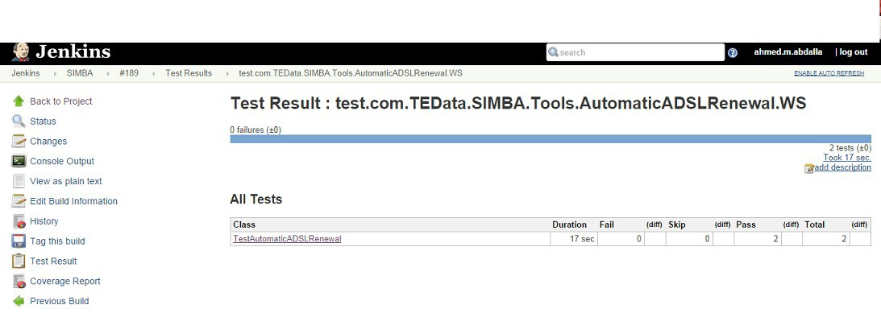
Test Report

Slide 26
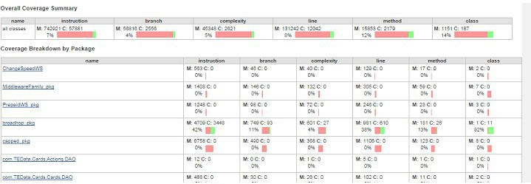
Test Code Coverage

Slide 27
Artifact uploaders
Tomcat
JBoss
Glassfish
WebSphere
FTP
SSH

Slide 28
UI Enhancement
Dashboard
Sectioned view
iPhone/Android

Slide 29
Security Management
Security Realm
LDAP
Jenkins's own user database
Delegate to servlet container
Authorization
Anyone can do anything
Logged-in users can do anything
Matrix-based security
Project-based Matrix Authorization Strategy
Legacy mode

Slide 30
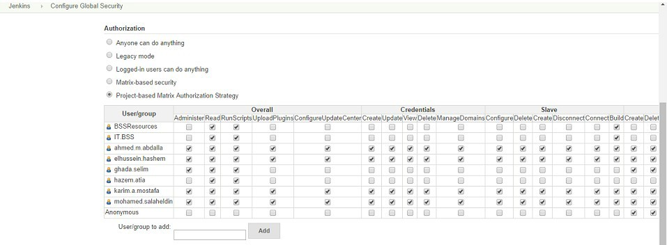
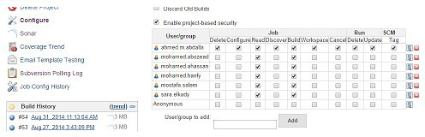
Security Management
Matrix-based security
Project-based Matrix Authorization

Slide 31
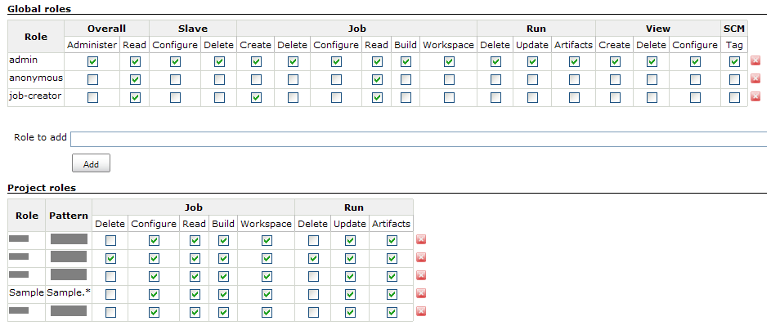
Security Management Plugins
Active directory, OpenID, MySQL, …
Role based privilege control

Slide 32
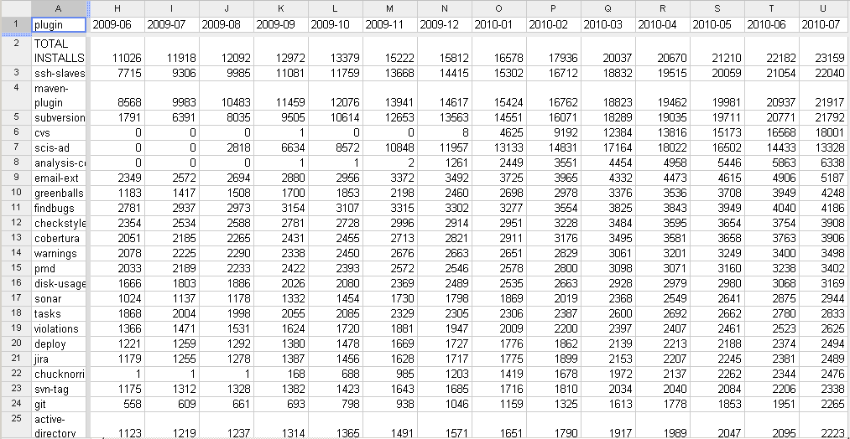
Plugin Usage Statistics
Ref: http://jenkins-ci.org/content/updated-usage-stats-available
32

Slide 33

Demo

Slide 34

Questions & Answers
34

